Slide 1

Exchange rate
USDCAD
Tejinder Sahni

Slide 2
Contents
Introduction
Purpose
Literature Review
Data
Data Compiling , Cleaning, Initial Analysis & The Final Data
The Bayesian Network
Methodology
The Initial Model
Model from the PC- Algorithm
Improved Model
Cross Validation
Network generated from Data Definitions
Comparing the two models
Using discretized data
Comparing the Models
Conditional Probabilities
Conclusion

Slide 3
Introduction
Floating exchange rate regime
The forces of supply and demand
Factors that increase demand for the Canadian dollar, or that decrease demand for US Dollar, will place downward pressure on the USDCAD exchange rate and vice versa
The increase in supply of Canadian Dollar or decrease in supply of US Dollar will push USDCAD higher and vice versa
Economic theory and empirical evidence have identified a number of exchange rate determinants that, in isolation from one another, have predictable effects on exchange rates.

Slide 4
Purpose
To find the factors and the extent to which they affect the USDCAD pair.
The research questions are:
What are the factors that cause the movement in the exchange rate?
Which top two factors in isolation or in combination have the maximum affect on the currency movement?

Slide 5
Literature Review
Javier H. Sandoval Archila of the National University of Columbia on the US Dollar Columbian Peso (USDCOP pair) based on technical indicators from the Limit Order Book and Transaction Price Interactions. This study involved Dynamic Bayesian Network to predict trend based features and market states.
Another interesting study was released in Dec 2013 by S. Villa and F. Stella [2] who built a Continuous Time Bayesian Network Classifier. Continuous time Bayesian Networks overcome the limitations of a Bayesian Network or a dynamic Bayesian Networks by representing temporal dynamics of the variables.
John Heaton conducted a study on Forecasting and Futurism in the July 2013 issue of the Society of Actuaries .Using daily data of six currency pairs (EUR/USD, USD JPY, GBP/USD, AUS/USD, USD/CHF, USD/CAD) along with two technical indicators naming 10 days and 20 days Simple Moving Averages he modelled a Bayesian Network and attempted to predict the direction of the exchange pairs at the point the SMA 10 crossed over SMA 20.

Slide 6
Attributes
Exchange Rate: The price at which one US dollar can be converted to one Canadian Dollar.
Oil Prices: Since Canada is a huge exporter of crude oil, the price of oil directly influences the amount of USD Canada will receive by selling the oil. Thus the price of oil directly influences the exchange rate .
Interest Rate Canada: Int_CA(%) Interest rate at which major financial institutions of a country borrow and lend overnight funds between themselves.
Interest Rate US: Int_US(%) Interest rate at which depository institutions lend balances held at the Federal Reserve to other depository institutions overnight.
Consumer Price Index Canada: cpi_CA(%) Change in the price of goods and services purchased by consumers. Consumer Price Index is a measure of overall inflation. Inflation is important to currency valuation because rising prices lead the central bank to raise interest to contain inflation.
Consumer Price Index US: cpi_US(%) Change in the price of goods and services purchased by consumers.
Employment change Canada: (Jobs_CA) Change in the number of employed people during the previous month. Job creation is an important leading indicator of consumer spending, which accounts for a majority of overall economic activity.
Non-Farm Payrolls: (Jobs_US) Change in the number of employed people during the previous month, excluding the farming industry.
ISM Manufacturing PMI: (Manu_Index_US) Level of a diffusion index based on surveyed purchasing managers in the manufacturing industry. It's a leading indicator of economic health - businesses react quickly to market conditions, and their purchasing managers hold perhaps the most current and relevant insight into the company's view of the economy.
Raw Material Price Index Canada: RMPI_CA Change in the price of raw materials purchased by manufacturers; It's a leading indicator of consumer inflation - when manufacturers pay more for goods the higher costs are usually passed on to the consumer.
Unemployment rate Canada: (unemp_CA(%) Percentage of the total work force that is unemployed and actively seeking employment during the previous month. Although it's generally viewed as a lagging indicator, the number of unemployed people is an important signal of overall economic health because consumer spending is highly correlated with labor-market conditions.
US Unemployment Rate: unemp_rate_US Percentage of the total work force that is unemployed and actively seeking employment during the previous month. Unemployment is a major consideration for those steering the country's monetary policy.
PPI Change in the price of finished goods and services sold by producers. It's a leading indicator of consumer inflation - When producers charge more for goods and services the higher costs are usually passed on to the consumer.
PPI Industry Data US
PPI Commodities US
Import price index US: Change in the price of imported goods and services purchased domestically; It contributes to inflation for businesses and consumers, especially those who rely heavily on imported goods and services
ISM Non-Manufacturing: Level of a diffusion index based on surveyed purchasing managers, excluding the manufacturing industry. It's a leading indicator of economic health - businesses react quickly to market conditions, and their purchasing managers hold the most current and relevant insight into the company's view of the economy
Interest Rate Differential: Int_Diff(%) The difference between the interest rate of Federal Bank US and the Bank of Canada Factor engineered from Interest Rate US and Interest Rate Canada.

Slide 7
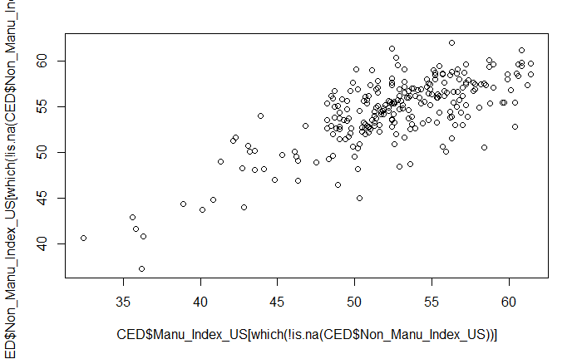

Slide 8
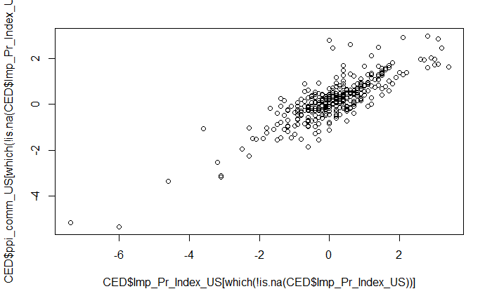

Slide 9
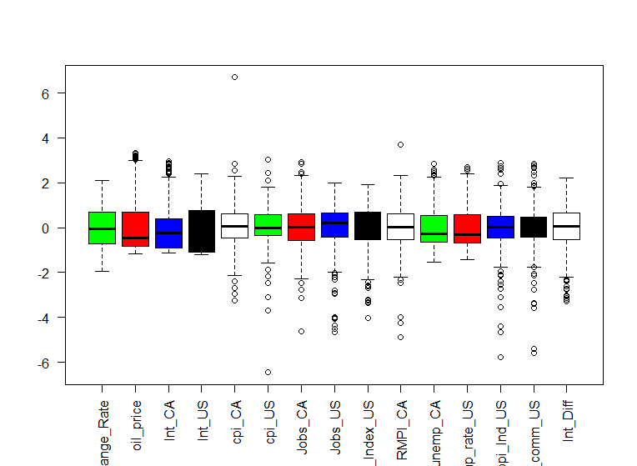
Data Cleaning

Slide 10
Data
Exchang_Rate oil price IntCA IntUS cpiCA cpiUS JobsCA JobsUS Ma_Index_US RMPI_CA unempCA unempUS ppi_IndUS ppi_commUS Int_Diff
1.2537 15.59 8.78 6.58 0.6 0.4 40700 276000 56.2 -2.6 7.8 5.7 0.19 0.1 -2.2
1.2544 15.37 8.78 6.58 0.6 0.4 40700 276000 56.2 -2.6 7.8 5.7 0.19 0.1 -2.2
1.2537 15.45 8.78 6.58 0.6 0.4 40700 276000 56.2 -2.6 7.8 5.7 0.19 0.1 -2.2
1.2536 15.49 8.78 6.58 0.6 0.4 40700 276000 56.2 -2.6 7.8 5.7 0.19 0.1 -2.2
1.2565 16.00 8.78 6.58 0.6 0.4 40700 276000 56.2 -2.6 7.8 5.7 0.19 0.1 -2.2
1.2570 16.29 8.78 6.58 0.6 0.4 40700 276000 56.2 -2.6 7.8 5.7 0.19 0.1 -2.2

Slide 11
The Bayesian Network
A Bayesian Network also called a belief network or probabilistic directed acyclic graphical model is a probabilistic graphical model that represents a set of variables and their conditional dependencies via a directed acyclic graph (DAG). The nodes represent the variables and the arcs represent the conditional dependencies .
Bayesian Networks can be used both as predictive and descriptive models. In prediction they can be a tool for solving posterior probability, classification etc. For descriptive purposes they can efficiently represent the dependence/independence relationships among the random variables of the data set or domain in question.

Slide 12
Methodology
Developing Bayesian network on continuous data (A Gaussian Bayesian Network ) . It is a BN all of whose variables are continuous and all of the Conditional Probability Distributions are linear Gaussians. Cross Validation based on correlation and mean squared error of observed vs predicted values was done on the developed network .
Another Bayesian Network was developed where the model was defined from the data definitions and experts’ views . The two models were then checked for their conditional probabilities of the target variable based on certain evidence and then compared with the observed conditional probability .
The data was discretized, and A Bayesian Network was developed on the resulting discrete data . Results between the observed and the predicted values were compared .

Slide 14
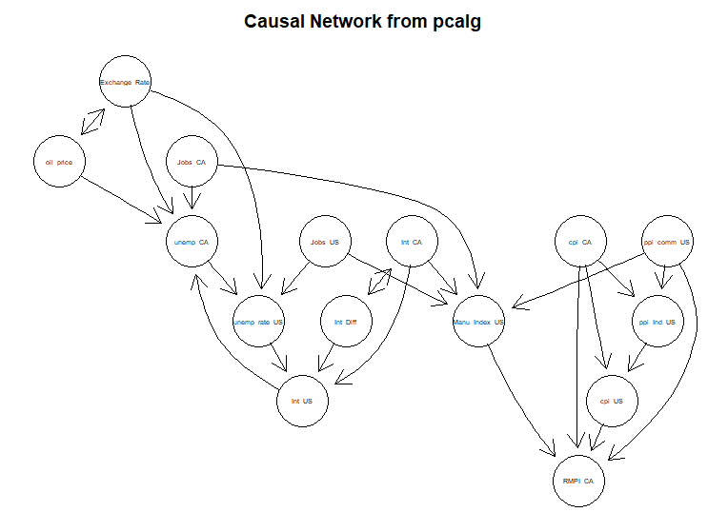

Slide 16
Parameters
Parameters of node Exchange_Rate (Gaussian distribution)
Conditional density: Exchange_Rate | oil_price + Int_CA + Int_US + cpi_CA + cpi_US + Jobs_CA + Jobs_US + Manu_Index_US + RMPI_CA + unemp_CA + unemp_rate_US + ppi_comm_US + Int_Diff
Coefficients:
(Intercept) oil_price Int_CA Int_US cpi_CA cpi_US Jobs_CA Jobs_US
2.097197e+00 -5.313186e-03 5.026182e-02 -7.743796e-02 3.550774e-02 -3.766553e-02 3.115086e-07 -6.824634e-08
Manu_Index_US RMPI_CA unemp_CA unemp_rate_US ppi_comm_US Int_Diff
-4.024060e-03 3.775659e-03 -5.921415e-03 -3.876139e-02 1.027794e-02 7.277333e-02
Standard deviation of the residuals: 0.06862524

Slide 17
Cross Validation
Loss Type → | Mean Squared Error between the Observed and the Predicted values of Exchange Rate | Predictive Correlation between the Observed and the Predicted values of Exchange Rate
Range | 0.004716 - 0.004725 | 0.0091437 - 0.0091446
Average | 0.00472 | 0.0091441

Slide 20
Comparing the two Models
Examples | Oil Price (evidence) | Interest Diff (evidence) | Exchange Rate (event) | Network Learned from Data | Network built from Data Definitions | Observed
1. | < 59 |  | >= 1.2 & <= 1.25 | .1157 | .0825 | .1053
2. |  | >=0 | >= 1.15 & <= 1.2 | .0910 | .0447 | .1141
3. | <59 | <= -2 | >= 1.2 & <= 1.25 | .1398 | .1145 | .1499

Slide 21
Discretized Data
Exchange_Rate | oil_price | Int_CA | Int_US | cpi_CA | cpi_US | Jobs_CA | Jobs_US | Manu_Index_US | RMPI_CA | unemp_CA | unemp_rate_US | ppi_Ind_US | ppi_comm_US | Int_Diff
(1.19,1.31] | [10.7,19.3] | (6.04,11.8] | (5.54,9.85] | (0.4,1] | (0.3,0.5] | (2.42e+04,4.17e+04] | (2.68e+05,5.24e+05] | (56.1,61.4] | [-6.81,-2] | (7.7,9.34] | (5.3,5.8] | (0.05,0.34] | (0.08,0.34] | [-4.28,-2.03]
(1.19,1.31] | [10.7,19.3] | (6.04,11.8] | (5.54,9.85] | (0.4,1] | (0.3,0.5] | (2.42e+04,4.17e+04] | (2.68e+05,5.24e+05] | (56.1,61.4] | [-6.81,-2] | (7.7,9.34] | (5.3,5.8] | (0.05,0.34] | (0.08,0.34] | [-4.28,-2.03]
(1.19,1.31] | [10.7,19.3] | (6.04,11.8] | (5.54,9.85] | (0.4,1] | (0.3,0.5] | (2.42e+04,4.17e+04] | (2.68e+05,5.24e+05] | (56.1,61.4] | [-6.81,-2] | (7.7,9.34] | (5.3,5.8] | (0.05,0.34] | (0.08,0.34] | [-4.28,-2.03]
(1.19,1.31] | [10.7,19.3] | (6.04,11.8] | (5.54,9.85] | (0.4,1] | (0.3,0.5] | (2.42e+04,4.17e+04] | (2.68e+05,5.24e+05] | (56.1,61.4] | [-6.81,-2] | (7.7,9.34] | (5.3,5.8] | (0.05,0.34] | (0.08,0.34] | [-4.28,-2.03]
(1.19,1.31] | [10.7,19.3] | (6.04,11.8] | (5.54,9.85] | (0.4,1] | (0.3,0.5] | (2.42e+04,4.17e+04] | (2.68e+05,5.24e+05] | (56.1,61.4] | [-6.81,-2] | (7.7,9.34] | (5.3,5.8] | (0.05,0.34] | (0.08,0.34] | [-4.28,-2.03]
(1.19,1.31] | [10.7,19.3] | (6.04,11.8] | (5.54,9.85] | (0.4,1] | (0.3,0.5] | (2.42e+04,4.17e+04] | (2.68e+05,5.24e+05] | (56.1,61.4] | [-6.81,-2] | (7.7,9.34] | (5.3,5.8] | (0.05,0.34] | (0.08,0.34] | [-4.28,-2.03]

Slide 24
Cross Validation of the Discrete Model

Slide 26
Usefulness of the study
Exchange rate forecasts are necessary to evaluate the foreign denominated cash flows involved in international transactions.
Exchange rate forecasting is very important to evaluate the benefits and risks attached to the international business environment.
The central banks make policies depending on the exchange rate predictions. The exchange rates can substantially affect the foreign trade equilibrium. A weaker currency can increase import costs and hence inflation in a country.
Big business houses with operations in numerous countries are affected daily by the exchange rates. Their exchange rate profits or losses can run into millions of dollars. They resort to practices like forward pricing, currency option, forward exchange contracts and rely on exchange rate studies.
Importers and Exporters time their shipments and payments depending on the exchange rates.
Tourism industry , Airlines are affected by exchange rates and make use of such studies.

Slide 27
Conclusion
The Exchange Rates of different currency pairs depend on numerous factors . These factors may fall into different categories . The major categories are fundamental which portray the health of economy of a Country and technical which are derived on the price , open, high , low , close , volume and the indicators derived from these Many different studies have been conducted in the past .
This study has analysed the affects of fundamental indicators on the exchange rate . The study was conducted on a database having fifteen variables including the target variable. Different models were learned , defined and compared to discover the attributes that cause a movement in exchange rate and the attributes which may cause the largest affect on the exchange rate .
It was found that the two main factors that cause the highest movement in the exchange are the oil price and the interest differential . The conditional probability graph of the discrete data clearly showed that given one variable the exchange rate was directly proportional to the interest differential and inversely proportional to the oil prices . The coefficients parameters of the fitted Gaussian Bayesian model also corroborate the findings . The conclusions are also perfectly in line with the held beliefs within the expert community .
The scope of the study can be widened to incorporate technicals’ like price , volume indicators also . The recent studies in the market indicate that exchange rate also depends on the sentiments in the trading community . Furthermore, the exchange rates of different currency pairs are also believed to be interdependent and movement in one may cause a corresponding movement in other .
Sentiment analysis can also be done which may involve analysing twitter trends and other social network sites for clues to the exchange rate movement . The exchange rates are also known to be affected by the stock market sentiments in the world .
A complete study in my view will have to incorporate fundamental , technical and sentiment analysis to devise an effective predictive model . These indicators may be analyzed together or separately where the output of model based on fundamental factors may be the input of the model based on technical factors, which may further be analysed in line with the sentiment analysis .

Slide 28
References
http://www.bdigital.unal.edu.co/55461/7/Javier%20H.%20SandovalA.2016.pdf
https://www.researchgate.net/publication/264751744_A_continuous_time_Bayesian_network_classifier_for_intraday_FX_prediction
https://www.soa.org/Search.aspx?q=bayesian+networks+for+predictive+modelling
D. Colombo and M. H. Maathuis, “A modification of the PC algorithm yielding order-independent skeletons,” ArXiv e-prints, Nov. 2012 https://arxiv.org/pdf/1211.3295.pdf
Bayesian Network Structure Learning , Parameter Learning and Inference : Package bnlearn
Methods for Graphical Models and Causal Inference : Package pcalg

